Slide 1
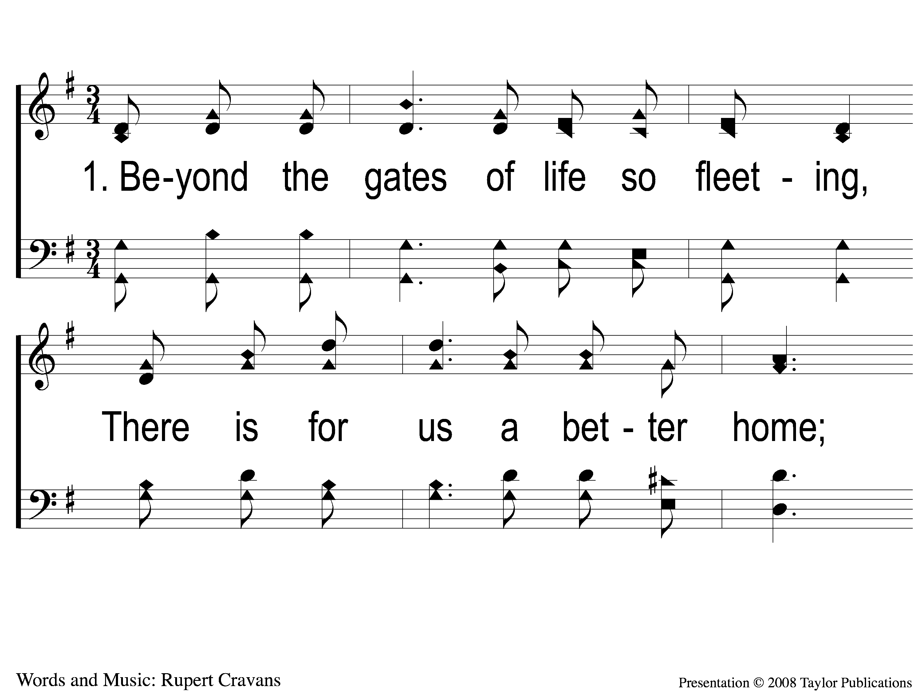
1-1 Beyond the Gates
Beyond the Gates
16

Slide 2
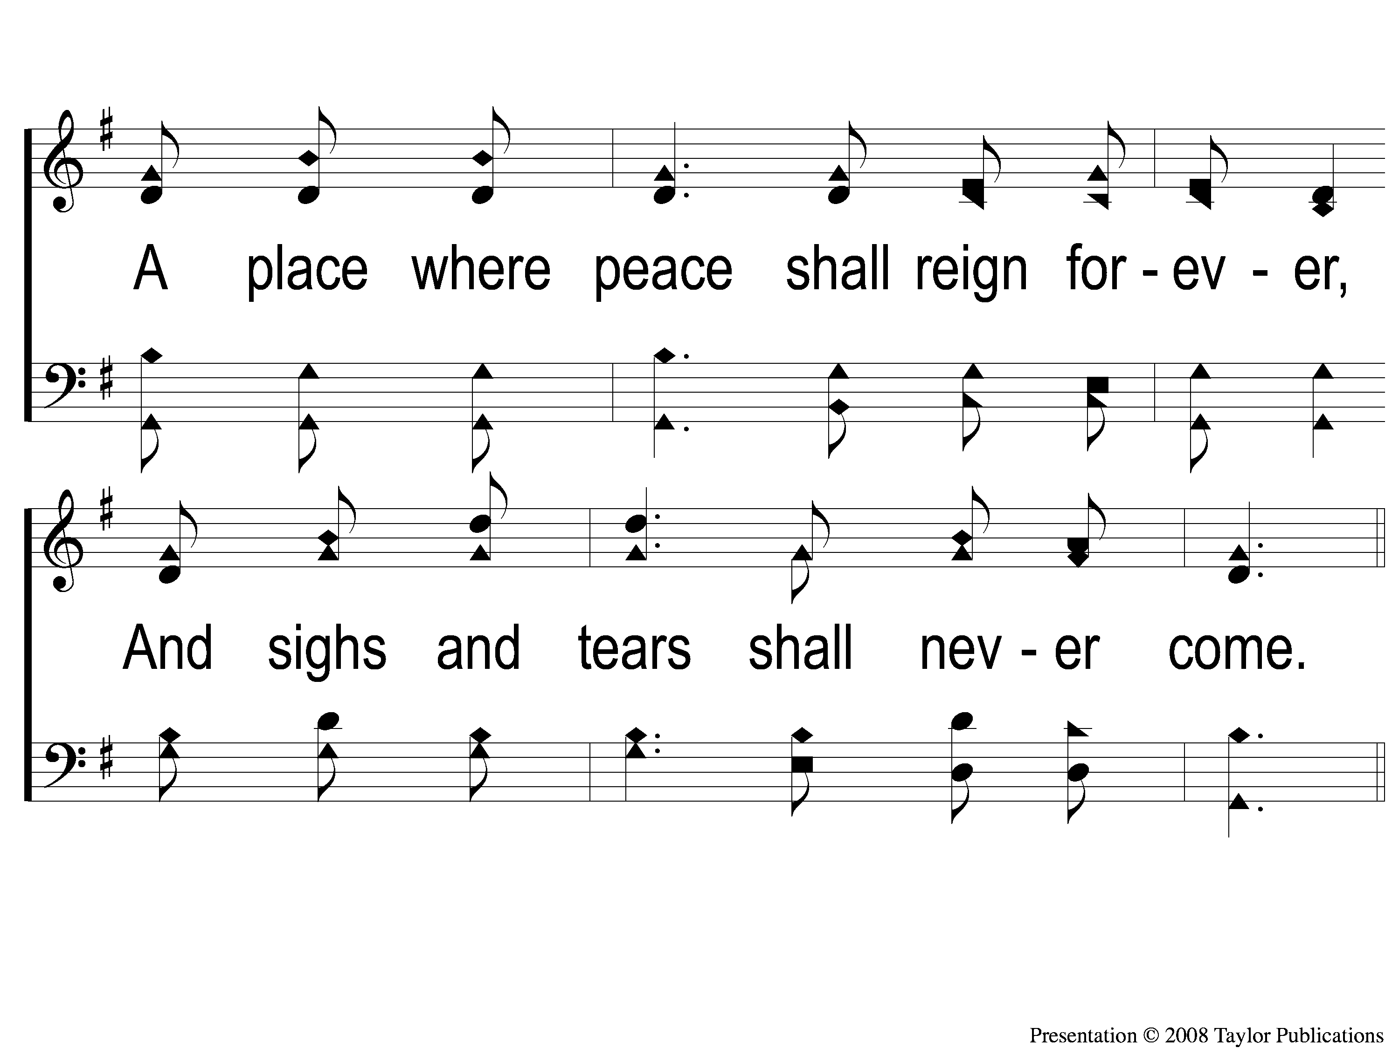
1-2 Beyond the Gates
Beyond the Gates
16

Slide 3
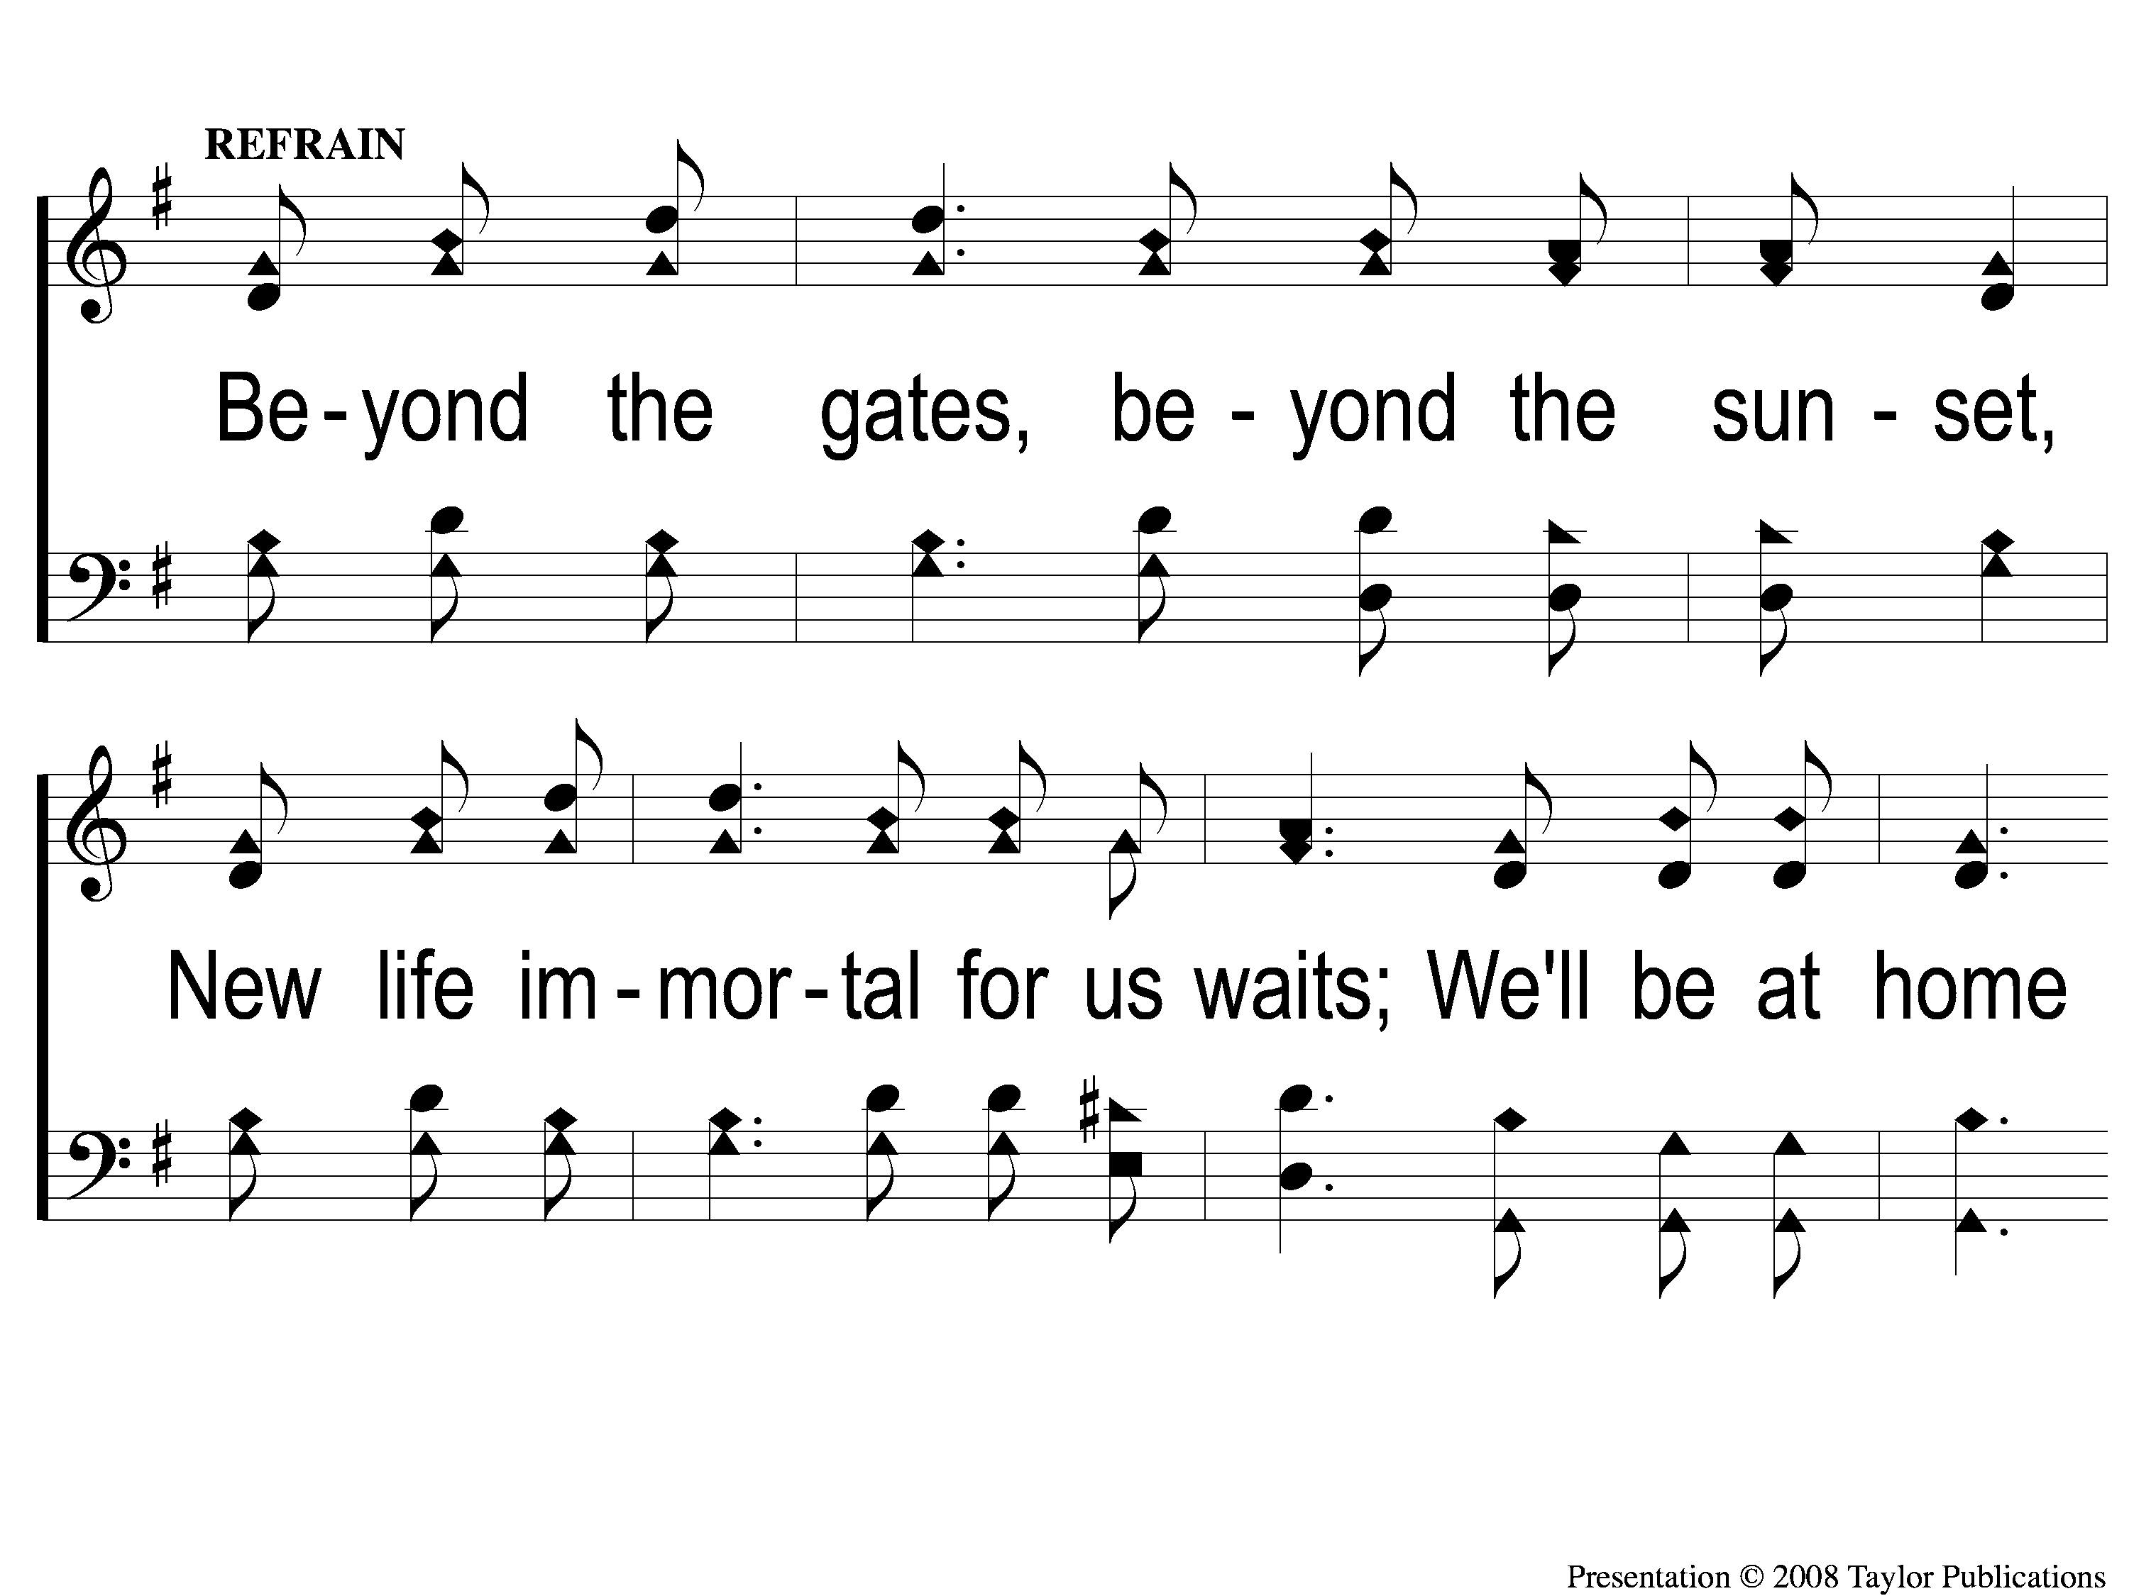
C-1 Beyond the Gates
Beyond the Gates
16

Slide 4
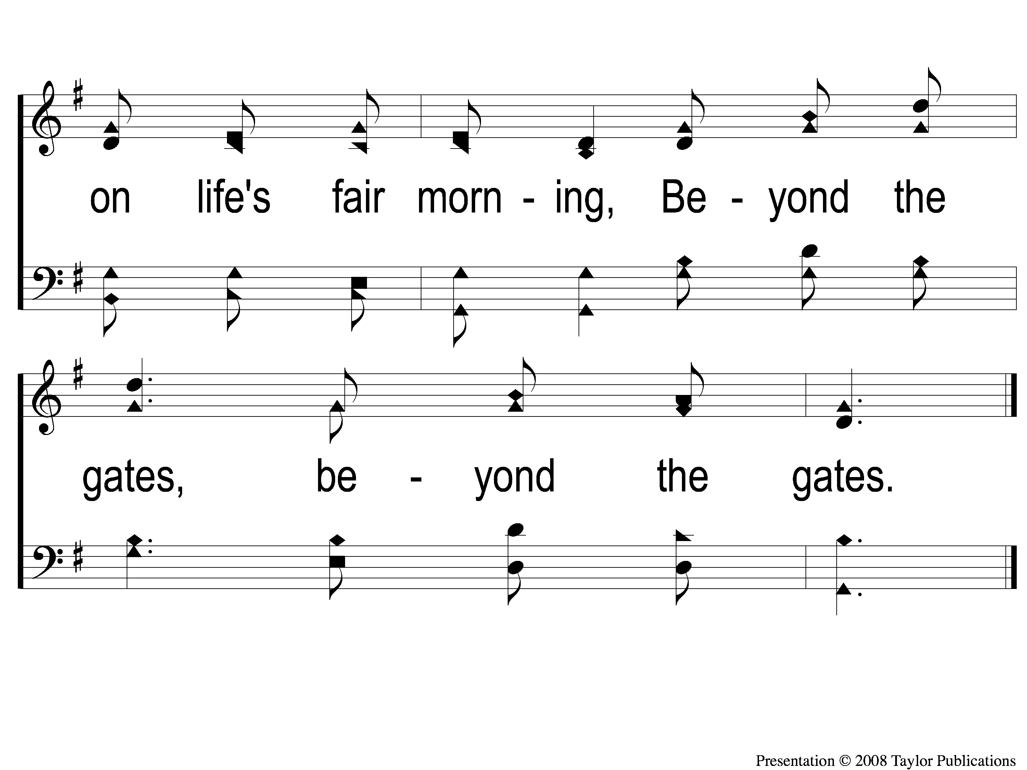
C-2 Beyond the Gates
Beyond the Gates
16

Slide 5
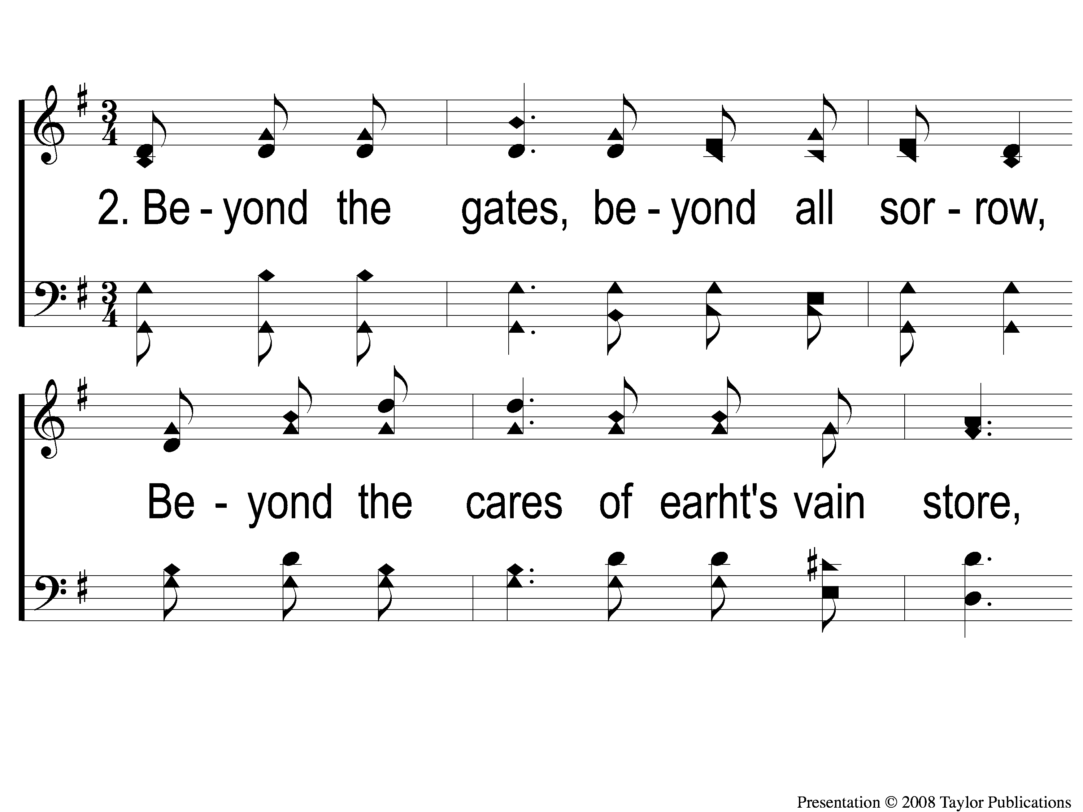
2-1 Beyond the Gates
Beyond the Gates
16

Slide 6
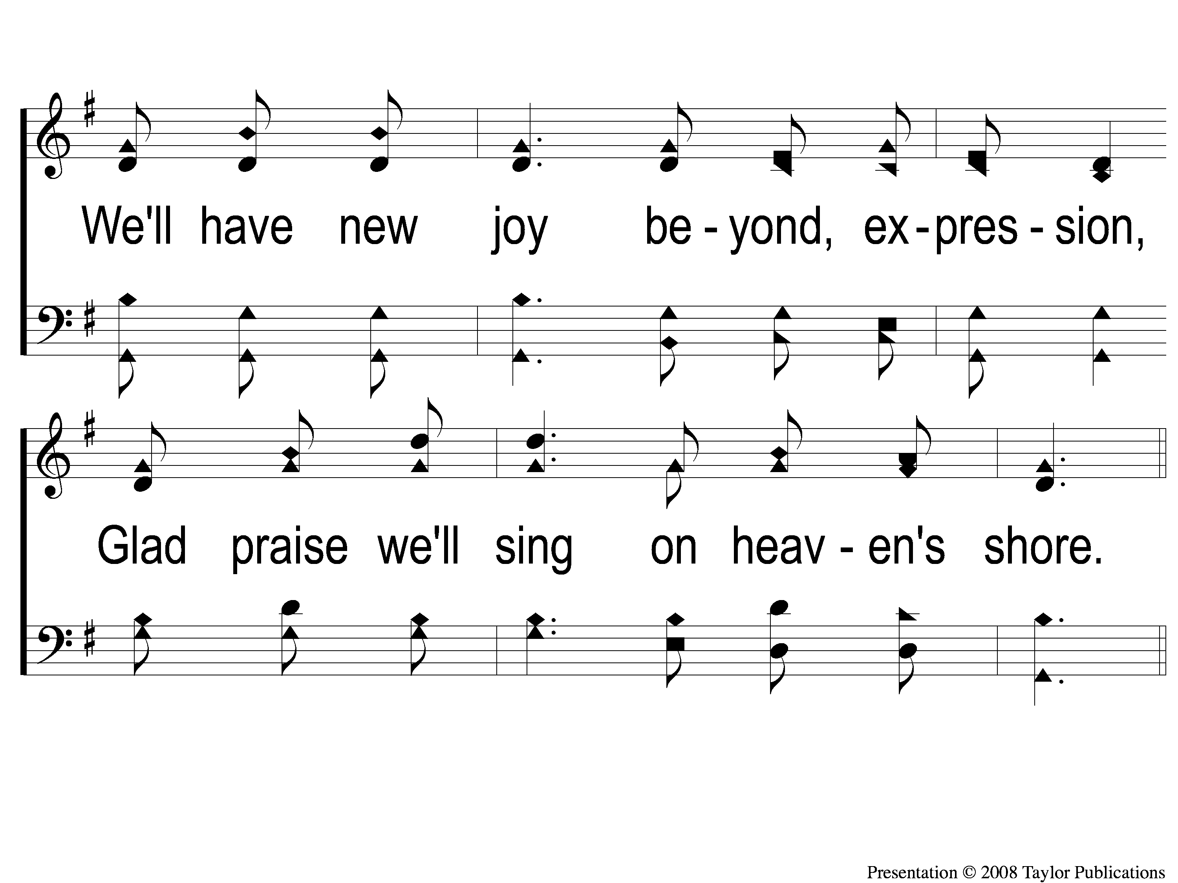
2-2 Beyond the Gates
Beyond the Gates
16

Slide 7
C-1 Beyond the Gates
Beyond the Gates
16

Slide 8
C-2 Beyond the Gates
Beyond the Gates
16

Slide 9
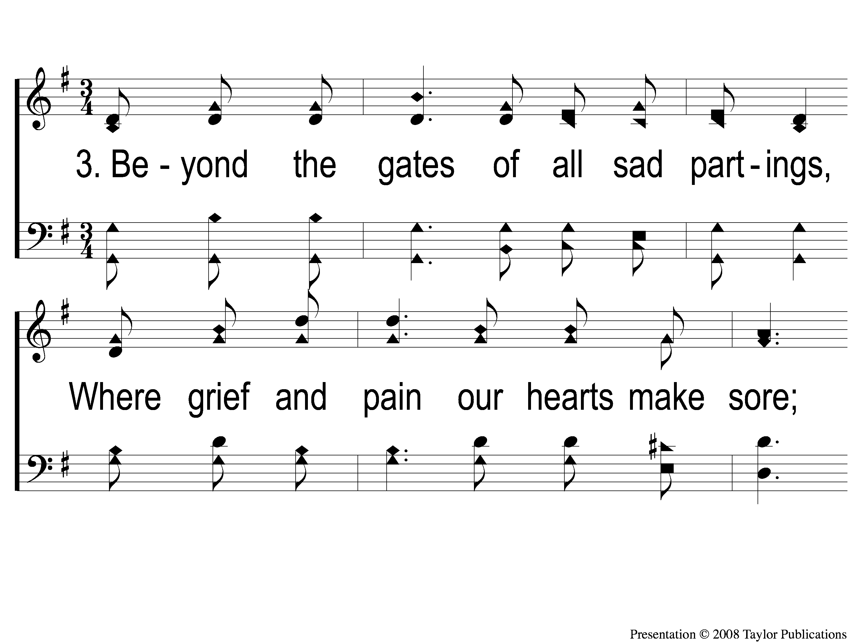
3-1 Beyond the Gates
Beyond the Gates
16

Slide 10
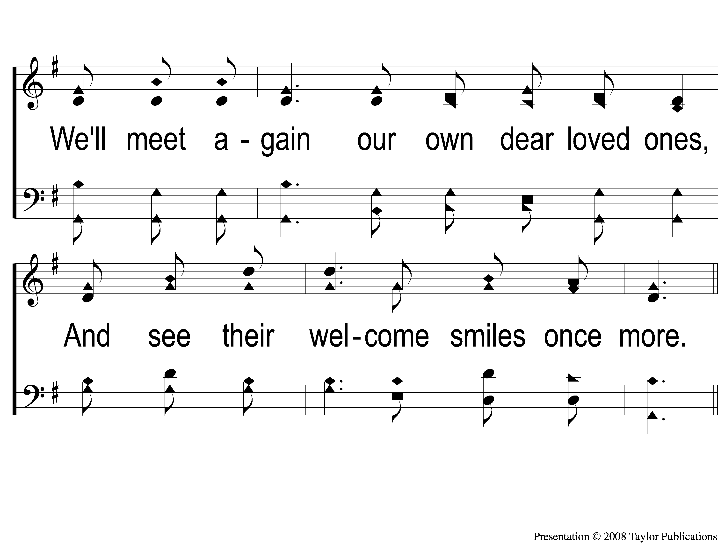
3-2 Beyond the Gates
Beyond the Gates
16

Slide 11
C-1 Beyond the Gates
Beyond the Gates
16

Slide 12
C-2 Beyond the Gates
Beyond the Gates
16

Slide 13
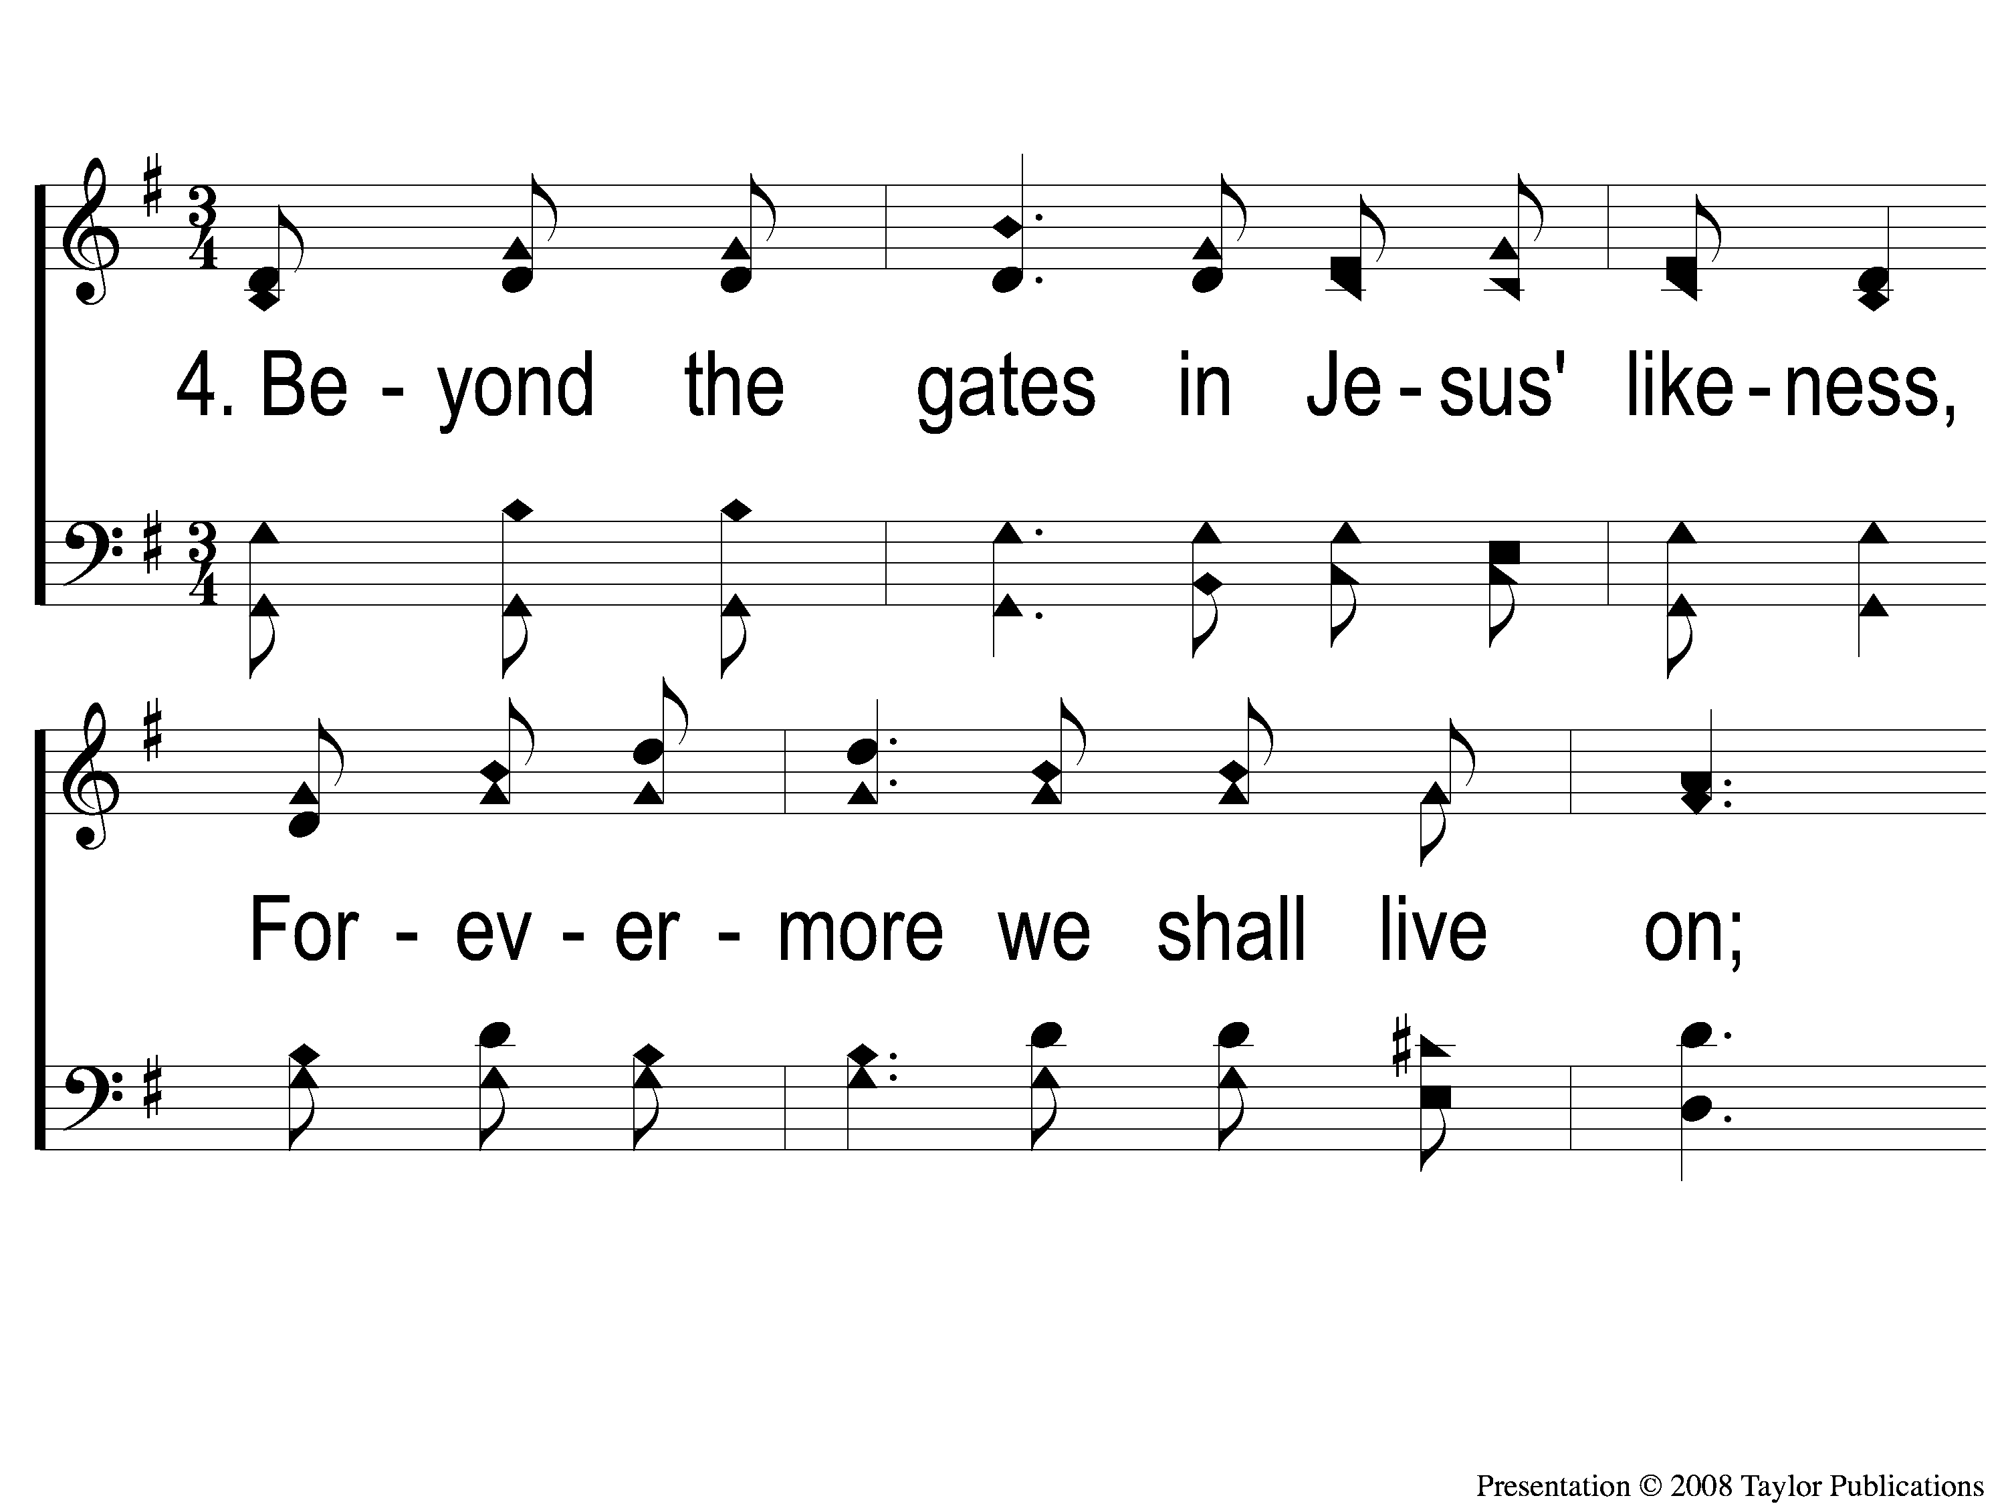
4-1 Beyond the Gates
Beyond the Gates
16

Slide 14
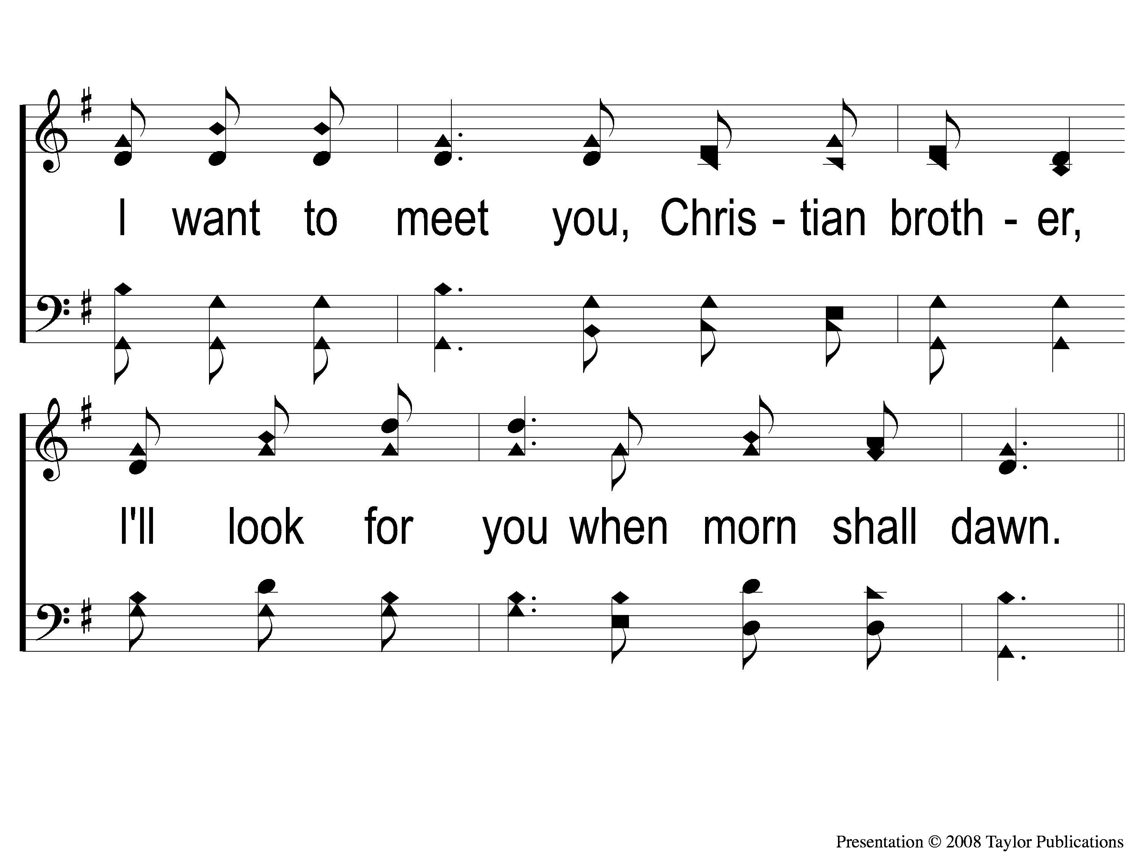
4-2 Beyond the Gates
Beyond the Gates
16

Slide 15
C-1 Beyond the Gates
Beyond the Gates
16

Slide 16
C-2 Beyond the Gates
Beyond the Gates
16

